Slide 1
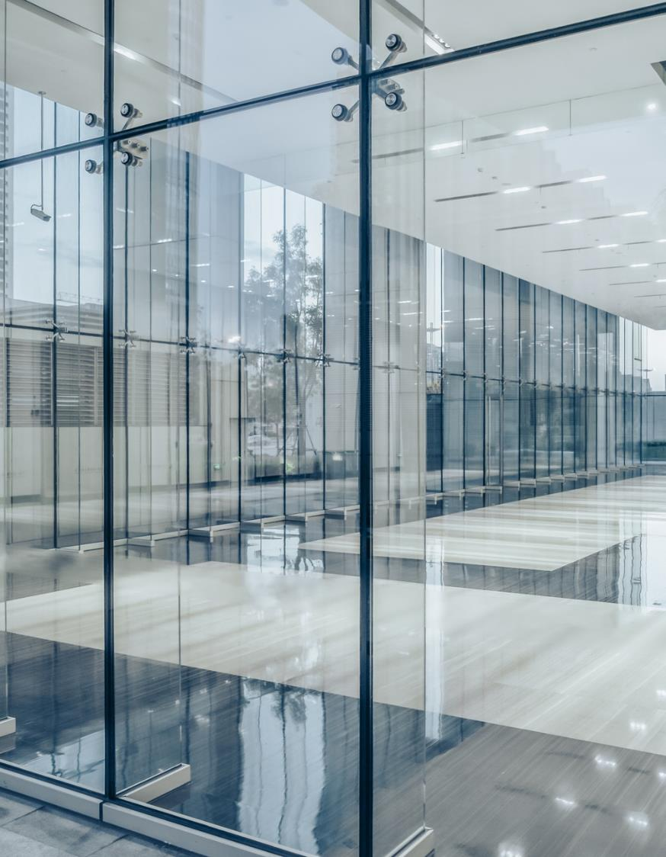
Network & Cloud solution for Power soft (PVT) Limited
Name: Rohan Nandasena
Reg.Number:E123283

Slide 2


Introduction
Power Soft is a startup software company that needs an upgraded network solution to provide security and redundancy.
Therefore, the goal of this project is to create a safe, redundant, and efficient network and cloud solution.

Slide 3
Aim & objectives
AIM
The aim is to design and implement a network infrastructure that will satisfy the company's goals and be scalable, redundancy, and secure.

Slide 4
Aim & objectives
Objectives
To improve departmental network security.
To increase the speed of the network.
To provide redundancy and protect company information.
To provide the business an appropriate backup database system.

Slide 5
Previous Network project issues.
Unsecured network.
A network is not redundant. The network is lagging.
Using a physical Data center.(costly, no data back up, physical location)

Slide 6
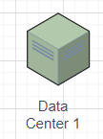
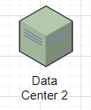

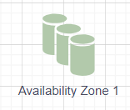
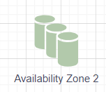
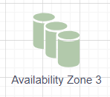
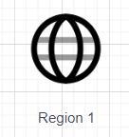
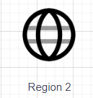
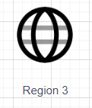
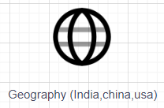
How it works.

Slide 7
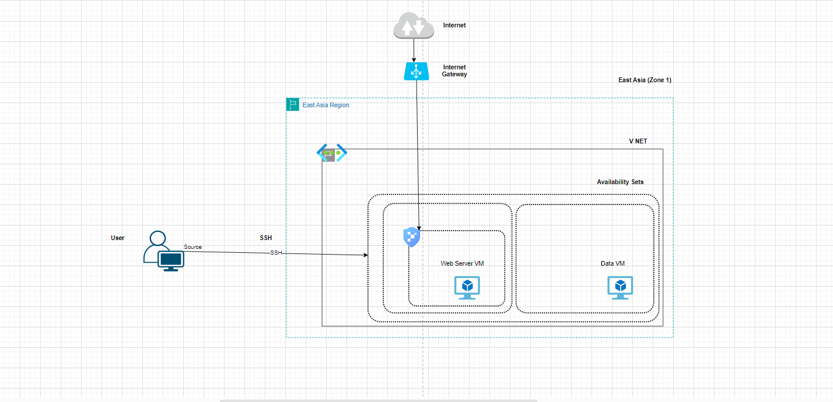
Azure Cloud Design

Slide 8
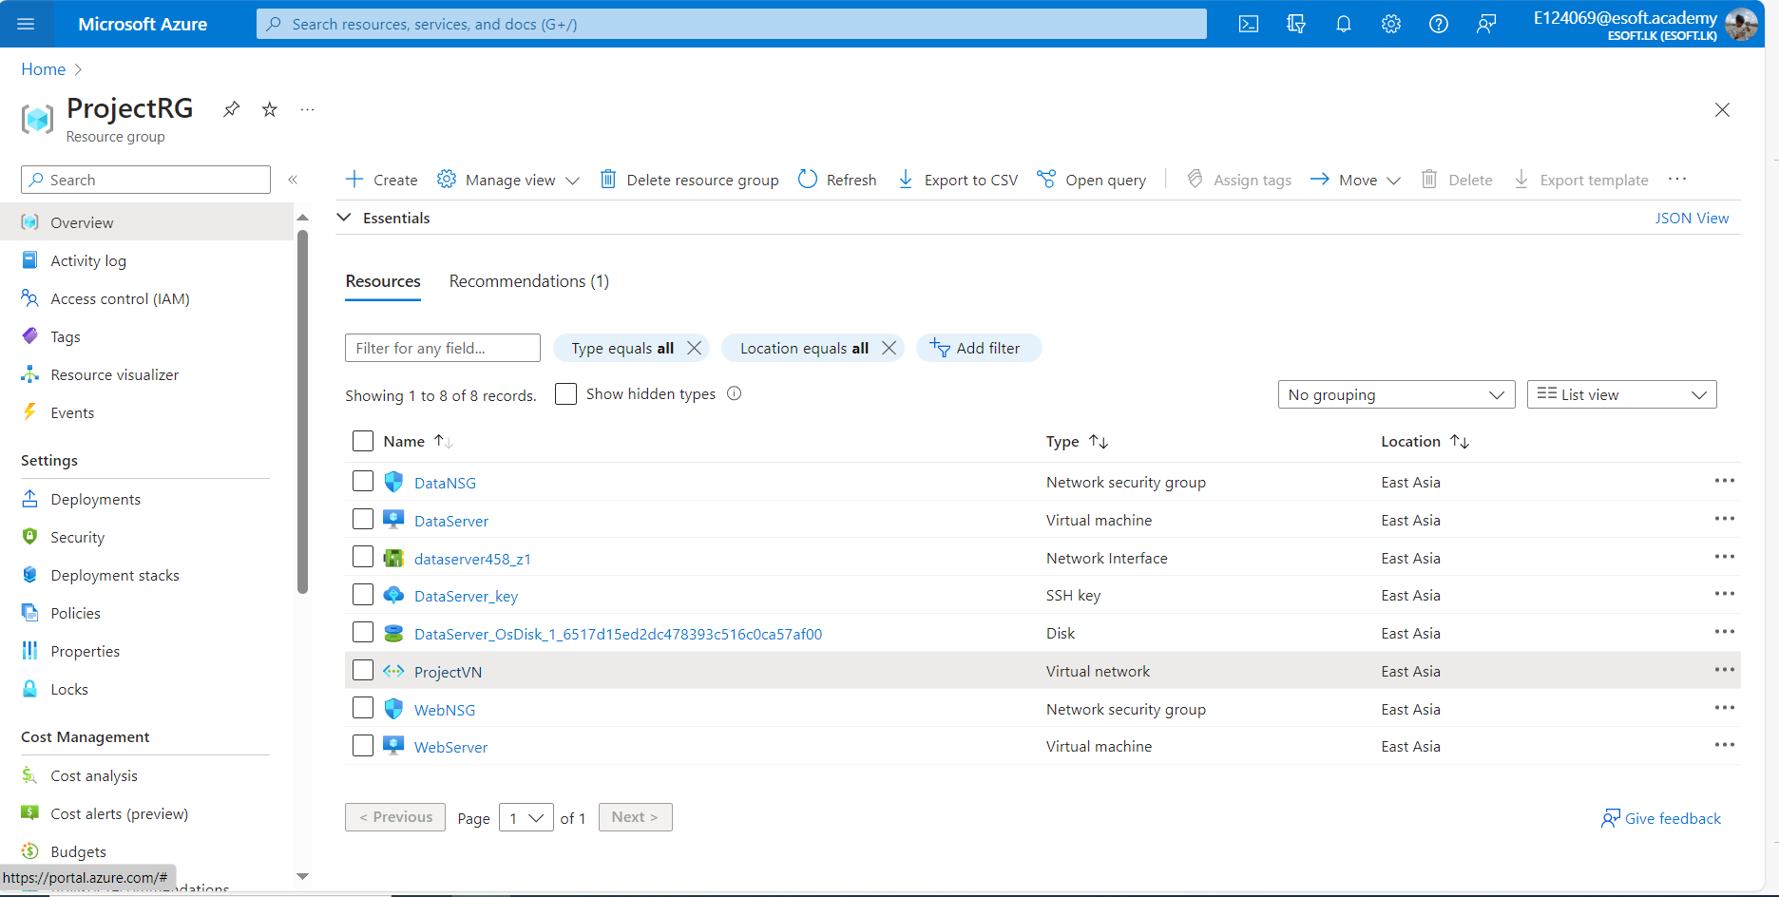
Azure Resources

Slide 9
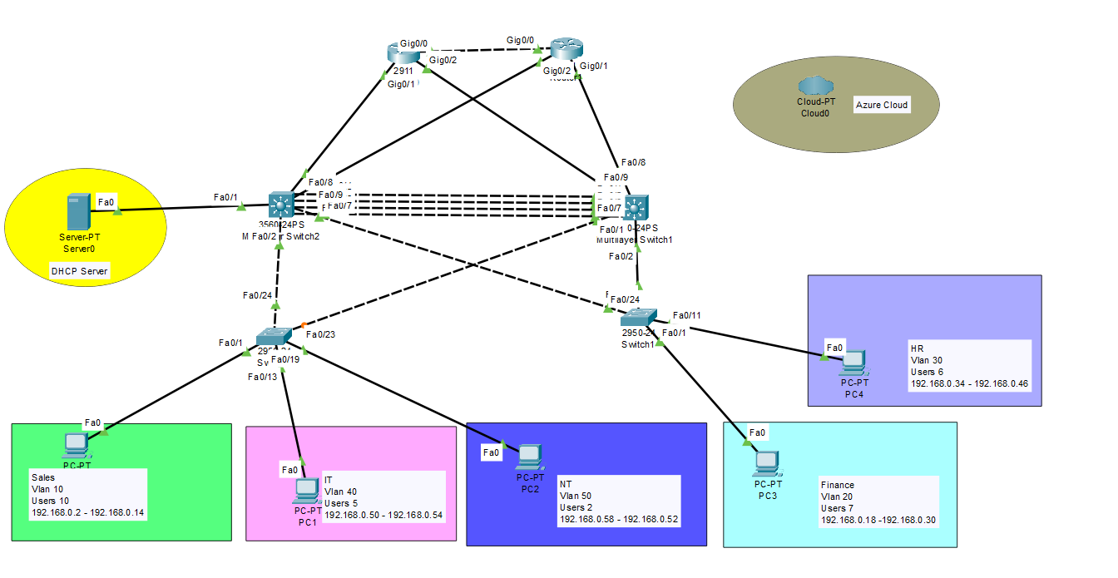
Network design

Slide 10
Ip Table
Department | Vlan | Block Size | No of Users | Network Id | Default Gateway | Usable IPs | Subnet Mask | Broadcast ID
Sales | 10 | 16 | 10 | 192.168.0.0 | 192.168.0.1 | 192.168.0.2 - 192.168.0.14 | 255.255.255.240 | 192.168.0.15
Finance | 20 | 16 | 7 | 192.168.0.016 | 192.168.0.17 | 192.168.0.18 - 192.168.0.30 | 255.255.255.240 | 192.168.0.31
HR | 30 | 16 | 6 | 192.168.0.32 | 192.168.0.33 | 192.168.0.34- 192.168.0.38 | 255.255.255.240 | 192.168.0.39
IT | 40 | 8 | 5 | 192.168.0.40 | 192.168.0.41 | 192.168.0.42 - 192.168.0.46 | 255.255.255.248 | 192.168.0.47
NT | 50 | 8 | 2 | 192.168.0.48 | 192.168.0.49 | 192.168.0.50 - 192.168.0.54 | 255.255.255.248 | 192.168.0.55

Slide 11
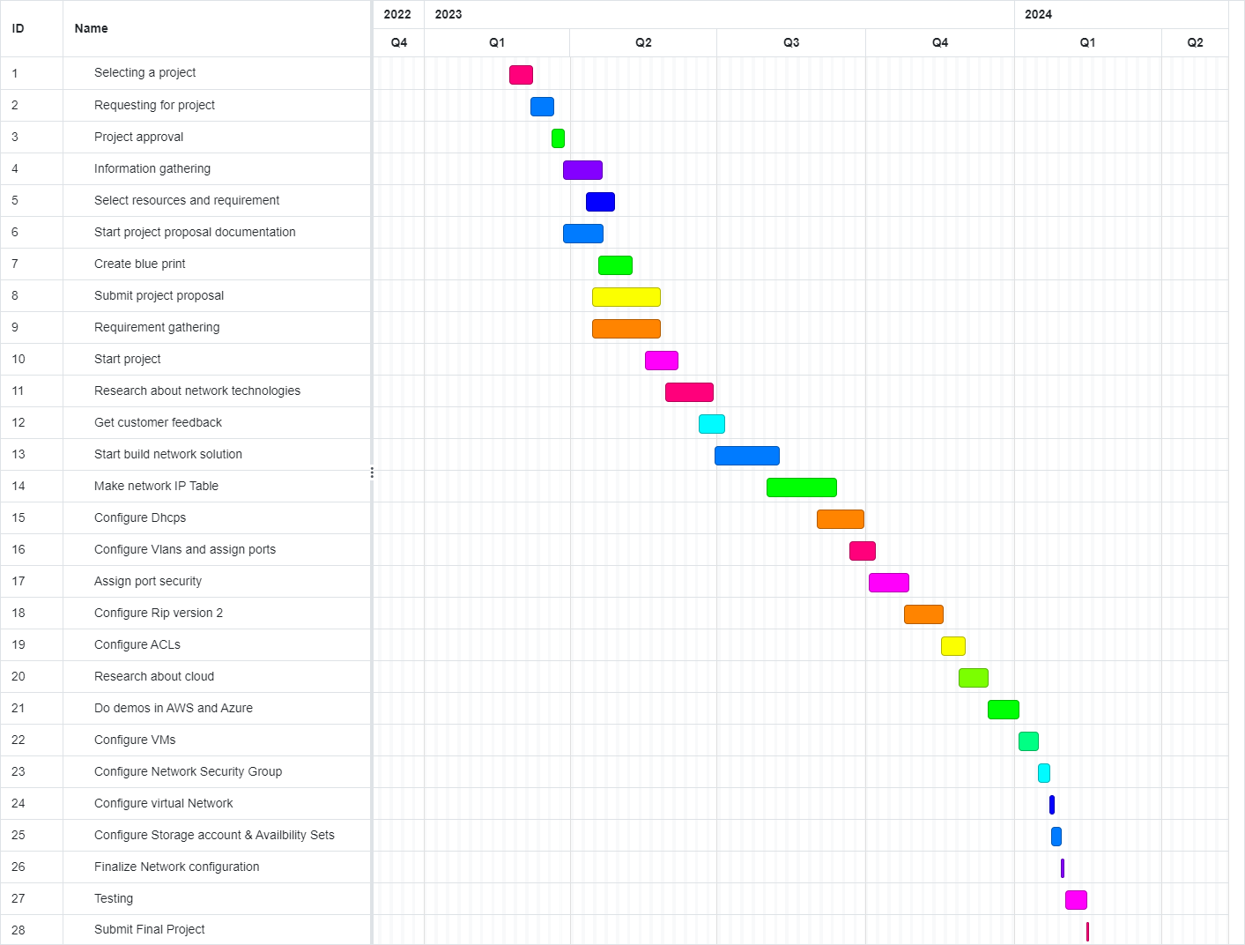
Gantt Chart

Slide 12
Budget plan
No: | Hardware Name /Software name | Per unit | cost | Quantity | Total Cost
1 | PCs | LKR 48000 |  | 32 | LKR 1,536,000
2 | 2960-24tt switch | LKR 332,500 |  | 2 | LKR 665,000
3 | Multilayer Switches 3560 | LKR 92364 |  | 2 | LKR 184,728
4 | Dhcp Server | LKR 616807 |  | 1 | LKR 616,807
5 | 2911 Routers | LKR 22000 |  | 3 | LKR 66,000
6 | Azure Cloud | LKR 39,130 |  | For 6 Months | LKR 234,600
7 | Sub Total |  |  |  | LKR 1,767,135

Slide 13



Summary
This project meets the security, redundancy, and efficiency requirements of the organization. and it's better than the previous project.

Slide 14
Future works
Assign a load balancer for high availability security and Microsoft Defender for security.
Install SSH server like openSSH.
any additional redundancy and security requirements for the network design.

Slide 15

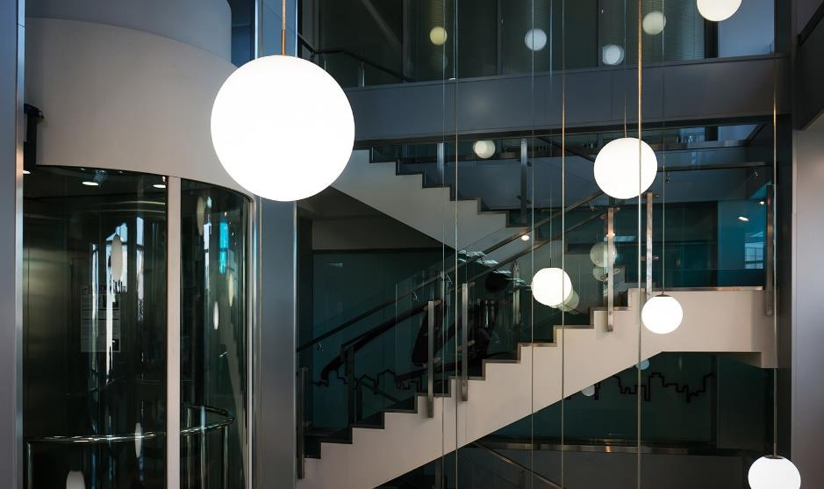
THANK YOU
Rohan Nandasena
rohannandasena094@gmail.com

